Slide 1


Azərbaycan Dövlət Neft və Sənaye Universiteti
Algorithms

Slide 2
The central concept in computer science is the algorithm – an ordered sequence of instructions that is guaranteed to solve a specific problem.
It is a list that looks something like this:
STEP 1: Do something
STEP 2: Do something
STEP 3: Do something
. ………………… .
. ………………… .
. ………………… .
STEP N: Stop, you are finished
Introduction

Slide 3
All the operations used to construct algorithms belong to one of only three categories:
Sequential operations
A sequential instruction carries out a single well-defined task.
When that task is finished, the algorithm moves on to the next operation.
Sequential operations are usually expressed as simple declarative sentences.
Introduction

Slide 4
For example,
Add 1 cup of butter to the mixture in the bowl.
Subtract the amount of the check from the current account balance.
Set the value of x to 1.
Introduction

Slide 5
Conditional operations
These are the “question-asking” instructions of an algorithm.
They ask a question, and the next operation is selected on the basis of the answer to that question.
For example,
If the mixture is too dry, then add one-half cup of water to the bowl.
Introduction

Slide 6
For example,
If the amount of the check is less than or equal to the current account balance, then cash the check; otherwise, tell the person that the account is overdrawn.
If x is not equal to 0, then set y equal to 1/x; otherwise, print an error message that says you cannot divide by 0.
Introduction

Slide 7
Iterative operations
These are the “looping” instructions of an algorithm.
They tell us not to go on to the next instruction but, instead, to go back and repeat the execution of a previous block of instructions.
For example,
Repeat the previous two operations until the mixture has thickened.
Introduction

Slide 8
For example,
While there are still more checks to be processed, do the following five steps.
Repeat steps 1, 2, and 3 until the value of y is equal to +1.
Introduction

Slide 9
We use algorithms (although we don’t call them that) all the time:
whenever we follow a set of instructions to assemble a child’s toy
bake a cake
balance a checkbook
go through the college registration process
etc.
Introduction

Slide 10
Mathematicians use algorithms all the time, and much of the work done by early Greek, Roman, Persian, and Indian mathematicians involved the discovery of algorithms for important problems in geometry and arithmetic.
An example is Euclid’s algorithm for finding the greatest common divisor of two positive integers.
We also studied algorithms in elementary school, even if we didn’t know it.
Introduction

Slide 11
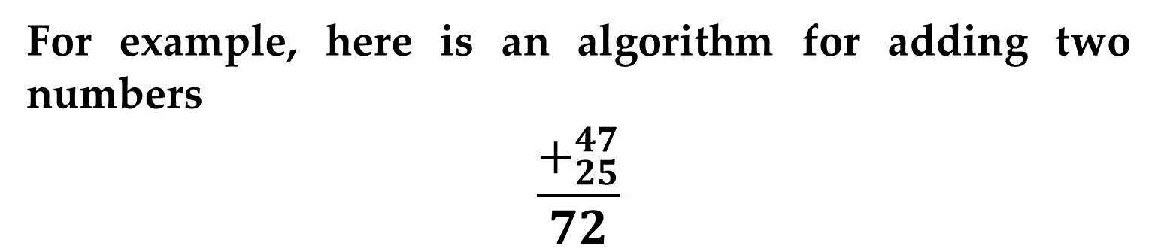
For example, here is an algorithm for adding two numbers
$$\frac{+_{25}^{47}}{72}$$
The instructions our teacher gave were as follows:
First add the rightmost column of numbers (7 + 5), getting the value 12.
Write down the 2 under the line and carry the 1 to the next column.
Introduction

Slide 12
Now move left to the next column, adding (4 + 2) and the previous carry value of 1 to get 7.
Write this value under the line, producing the correct answer 72.
Introduction

Slide 13
A Bit of History
The word algorithm is derived from the last name of Muhammad ibn Musa Al-Khwarizmi, a famous Persian mathematician and author from the eighth and ninth centuries.
Al-Khwarizmi was a teacher at the Mathematical Institute in Baghdad and the author of the book “Kitab al jabr w’al muqabala”, which in English means “Rules of Restoration and Reduction.”

Slide 14
A Bit of History
It is one of the earliest mathematical textbooks, and its title gives us the word algebra (the Arabic word “al jabr” means “reduction”).
In 825 A.D., Al-Khwarizmi wrote another book about the base-10 positional numbering system that had recently been developed in India.
Introduction

Slide 15
A Bit of History
In this book he described formalized, step-by-step procedures for doing arithmetic operations, such as addition, subtraction, and multiplication, on numbers represented in this new decimal system.
In the twelfth century this book was translated into Latin, introducing the base-10 Hindu-Arabic numbering system to Europe.
Introduction

Slide 16
A Bit of History
His last name was rendered as “Algoritmi” in Latin characters, and eventually the formalized procedures that he pioneered and developed became known as “algorithms” in his honor.
Introduction

Slide 17
Why would we take such a simple task as adding two numbers and express it in so complicated a fashion?
Why are formal algorithms so important in computer science?
Because of the following fundamental idea:
If we can specify an algorithm to solve a problem, then we can automate its solution.
Introduction

Slide 18
Once we have formally specified an algorithm, we can build a machine (or write a program or hire a person) to carry out the steps contained in the algorithm.
The machine (or program or person) does not need to understand the concepts or ideas underlying the solution.
It merely has to do step 1, step 2, step 3, . . . exactly as written.
Introduction

Slide 19
In computer science terminology, the machine, robot, person, or thing carrying out the steps of the algorithm is called a computing agent.
Introduction

Slide 20
Much of the research and development work in computer science involves
discovering correct and efficient algorithms for a wide range of interesting problems
studying their properties
designing programming languages into which those algorithms can be encoded
designing and building computer systems that can automatically execute these algorithms in an efficient manner.

Slide 21
At first glance, it may seem that every problem can be solved algorithmically.
However, (first proved by the German logician Kurt Gödel in the early 1930s) there are problems for which no generalized algorithmic solution can possibly exist.
These problems are, in a sense, unsolvable.
Gödel’s discovery effectively places a limit on the capabilities of computers and computer scientists.
Introduction

Slide 22
There are also problems for which it is possible to specify an algorithm but a computing agent would take so long to execute it that the solution is essentially
useless.
Example
To get a computer to play winning chess, we could adopt a brute force approach.
Introduction

Slide 23
Example (continued)
Given a board position as input, the computer would
examine every legal move it could possibly make
then every legal response an opponent could make to each initial move
then every response it could select to that move
and so on.
This analysis would continue until the game reached a win, lose, or draw position.
Introduction

Slide 24
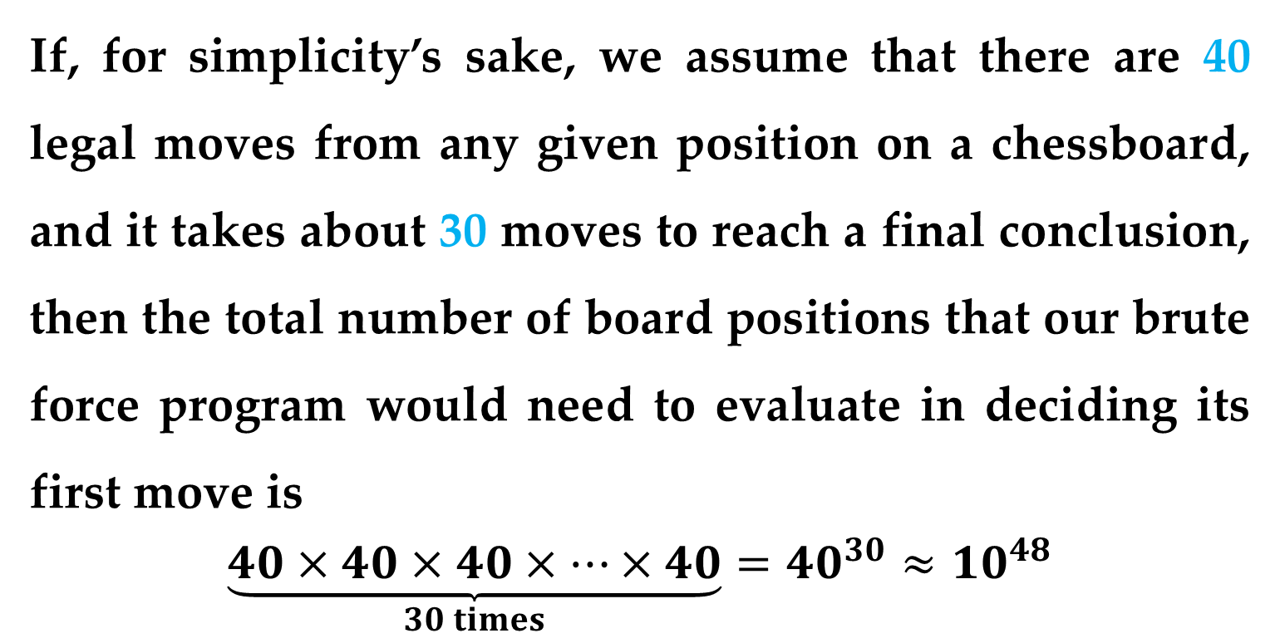
Example (continued)
With that information the computer would be able to optimally choose its next move.
If, for simplicity’s sake, we assume that there are 40 legal moves from any given position on a chessboard, and it takes about 30 moves to reach a final conclusion, then the total number of board positions that our brute force program would need to evaluate in deciding its first move is
$$\underset{30 times}{\underbrace{40×40×40×…×40}}=40^{30}≈10^{48}$$

Slide 25
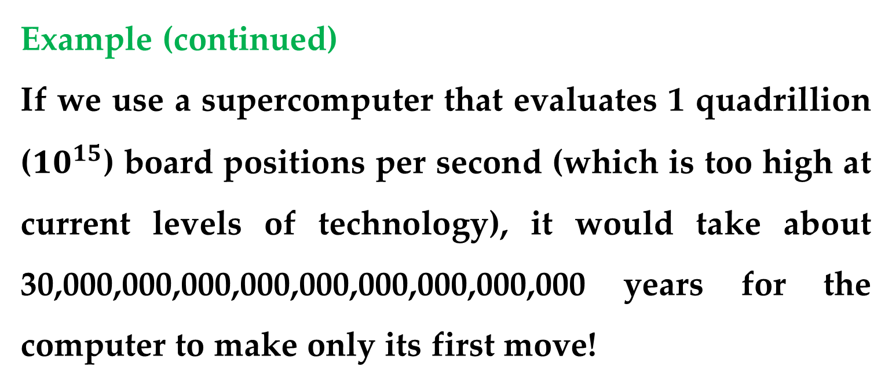
Example (continued)
If we use a supercomputer that evaluates 1 quadrillion ($10^{15}$) board positions per second (which is too high at current levels of technology), it would take about 30,000,000,000,000,000,000,000,000,000 years for the computer to make only its first move!
Obviously, a computer could not use a brute force technique to play a real chess game.
Introduction

Slide 26
There also exist problems that we do not yet know how to solve algorithmically.
Many of these involve tasks that require a degree of what we term “intelligence”.
Example
After only a few days a baby recognizes the face of its mother from among the many faces it sees.
Introduction

Slide 27
Example
In a few months it begins to develop coordinated sensory and motor control skills and can efficiently plan how to use them — how to get from the playpen to the toy on the floor without bumping into either the chair or the desk that are in the way.
After a few years the child begins to develop powerful language skills and abstract reasoning capabilities.
Introduction

Slide 28
We take these abilities for granted, but the operations just mentioned —
sophisticated visual discrimination
high-level problem solving
abstract reasoning
natural language understanding
— cannot be done well (or even at all) using the computer systems and software packages currently available.
Introduction

Slide 29
The primary reason is that researchers do not yet know how to specify these operations algorithmically.
That is, they do not yet know how to specify a solution formally in a detailed step-by-step fashion.
Thus, algorithmic problem solving has many variations.
However, discovering an algorithmic solution has enormously important consequences.
Introduction

Slide 30
If we can create a correct and efficient algorithm to solve a problem, and if we encode it into a programming language, then we can take advantage of the speed and power of a computer system to automate the solution and produce the desired result.
This is what computer science is all about.
Introduction

Slide 31
Flowchart
Flowchart
Graphical representation of an algorithm
Drawn using certain special-purpose symbols connected by arrows called flowlines
Rectangle symbol (action symbol):
Indicates any type of action
Oval symbol:
Indicates the beginning or end of a program or a section of code
Single-entry/single-exit control structures
Connect exit point of one control structure to entry point of the next (control-structure stacking)
Makes programs easy to build

Slide 32
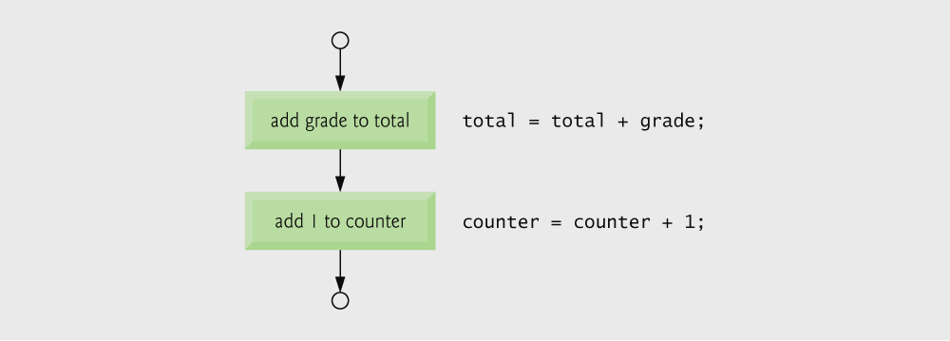
Flowcharting C’s sequence structure

Slide 33
The if Selection Statement
Pseudocode statement in C:
if ( grade >= 60 ) printf( "Passed\n" );
C code corresponds closely to the pseudocode
Diamond symbol (decision symbol)
Indicates decision is to be made
Contains an expression that can be true or false
Test the condition, follow appropriate path

Slide 34
The if Selection Statement
Selection structure:
Used to choose among alternative courses of action
Pseudocode:
If student’s grade is greater than or equal to 60 Print “Passed”
If condition true
Print statement executed and program goes on to next statement
If false, print statement is ignored and the program goes onto the next statement
Indenting makes programs easier to read
C ignores whitespace characters

Slide 35
The if…else Selection Statement
if
Only performs an action if the condition is true
if…else
Specifies an action to be performed both when the condition is true and when it is false
Psuedocode:
If student’s grade is greater than or equal to 60 Print “Passed”
else Print “Failed”
Note spacing/indentation conventions

Slide 36
The if…else Selection Statement
C code:
if ( grade >= 60 )
printf( "Passed\n");
else
printf( "Failed\n");
Ternary conditional operator (?:)
Takes three arguments (condition, value if true, value if false)
Our pseudocode could be written:
printf( "%s\n", grade >= 60 ? "Passed" : "Failed" );
Or it could have been written:
grade >= 60 ? printf( “Passed\n” ) : printf( “Failed\n” );

Slide 37
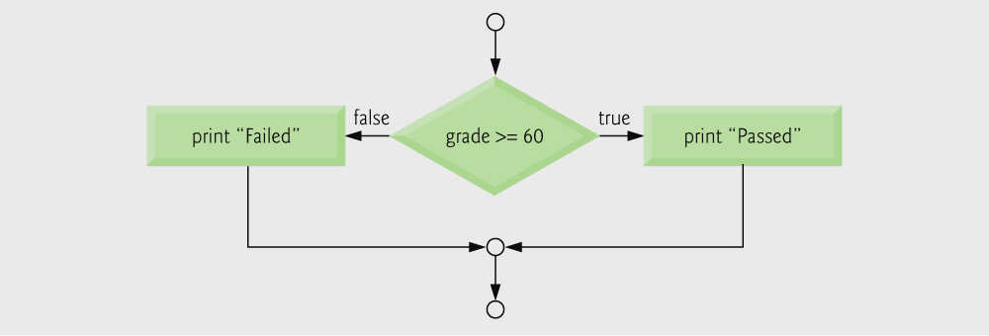
The if…else Selection Statement
Flow chart of the if…else selection statement
Nested if…else statements
Test for multiple cases by placing if…else selection statements inside if…else selection statement
Once condition is met, rest of statements skipped
Deep indentation usually not used in practice

Slide 38
Thank You for Attention

